Slide 1

A SMART PERSONAL PRODUCTIVITY DASHBOARD USING QUEUE-BASED TASK SCHEDULING, TREE-BASED GOAL MANAGEMENT, STACK-BASED ACTIVITY HISTORY, AND HASH-BASED UNIVERSAL SEARCH
CSA0307 – DATA STRUCTURE
CAPSTONE PROJECT PRESENTATION
Presented by
PURUSHOTHAMAN. V – 192511064
KAVIN ADHITHYA R.S – 192511365
MOHAMMED JILAN. S - 192521386
Supervised by
Dr. K. KIRUTHIKA

Slide 2


OBJECTIVES
To develop a smart dashboard that helps users manage their daily tasks, goals, and notes in one place.
To improve personal productivity by organizing schedules, tracking progress, and monitoring daily activities.
To demonstrate the practical use of data structures such as Queue, Tree, Stack, and Hash Map in a real-world application.
To provide a simple, user-friendly, and efficient dashboard for students and professionals to manage their daily work

Slide 3
LITERATURE REVIEW
S.No | Title of the Paper | Publisher & Year | Components / Techniques Used
1 | Design and Development of a Smart Personal Productivity Dashboard | IEEE, 2024 | Dashboard UI, Task Management, Productivity Analytics
2 | Queue-Based Task Scheduling for Personal Productivity Applications | Springer, 2023 | Queue, Task Scheduling, Time Management
3 | Tree-Based Goal Management System for Productivity Applications | Elsevier, 2024 | Tree Data Structure, Goal Hierarchy, Progress Tracking
4 | Hash-Based Universal Search for Personal Information Systems | ACM Digital Library, 2023 | Hash Map, Fast Search, Data Retrieval
5 | Stack-Based Activity History Management in Productivity Systems | IEEE, 2025 | Stack, Activity History, Undo/Redo Operations

Slide 4
PROBLEM STATEMENT
Students and professionals often use multiple applications to manage tasks, goals, notes, and schedules, making it difficult to stay organized.
Switching between different platforms wastes time and reduces productivity.
Existing systems do not efficiently organize information or provide quick access to recent activities and important data.
There is a need for a Smart Personal Productivity Dashboard that integrates task scheduling, goal management, activity history, and universal search using efficient data structures for better productivity.

Slide 5
PROPOSED OBJECTIVE
Develop a Smart Personal Productivity Dashboard to manage daily activities in one platform.
Implement Queue-Based Task Scheduling for efficient task organization.
Design Tree-Based Goal Management to organize goals and sub-goals systematically.
Integrate Stack-Based Activity History and Hash-Based Universal Search for quick access and efficient information retrieval.

Slide 6
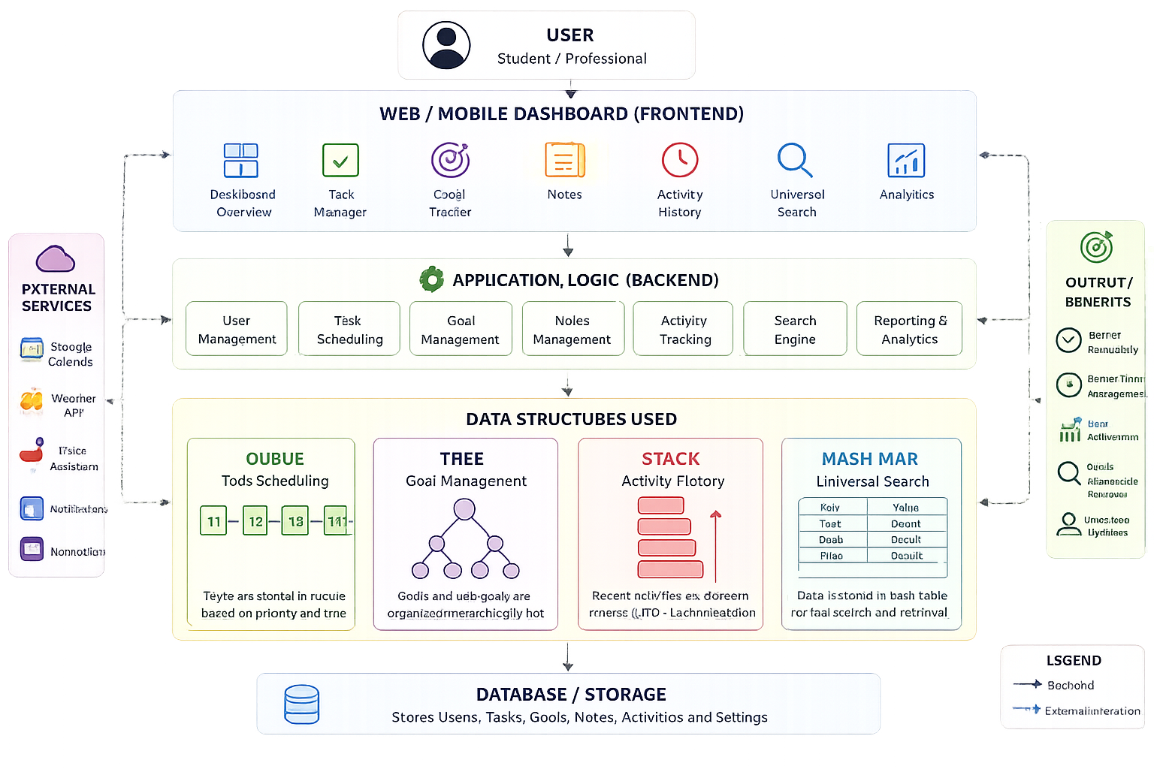
SYSTEM ARCHITECTURE

Slide 7
METHODOLOGY
User Login – The user accesses the Smart Productivity Dashboard.
Data Entry – The user adds tasks, goals, notes, and daily activities.
Data Processing – Queue schedules tasks, Tree organizes goals, Stack stores activity history, and Hash Map enables fast search.
Storage – All information is saved in the database.
Dashboard Output – The system displays productivity insights, task status, goal progress, and search results.

Slide 8
SDG
SDG 4 – Quality Education
Improves study planning and time management.
Helps students organize tasks, notes, and goals.
Enhances productivity and learning efficiency.
Supports better academic performance.
SDG 8 – Decent Work and Economic Growth
Improves personal productivity and work efficiency.
Helps professionals manage daily tasks effectively.

Slide 9
CONCLUSION
The LifeOS: Smart Personal Productivity Dashboard provides a simple and efficient way to manage daily tasks, goals, notes, and activities in one platform.
It demonstrates the practical application of Queue, Tree, Stack, and Hash Map data structures in solving real-world productivity problems.
The dashboard improves organization, saves time, and enables quick access to information through a user-friendly interface.
This project can be further enhanced by integrating AI features, cloud storage, and mobile support in the future.

Slide 10
REFERENCES
Cormen, T. H., Leiserson, C. E., Rivest, R. L., & Stein, C. (2022). Introduction to Algorithms (4th Edition).
MIT Press. Jay Wengrow. (2020). A Common-Sense Guide to Data Structures and Algorithms (2nd Edition).
Pragmatic Bookshelf. Loiane Groner. (2023). Data Structures and Algorithms in JavaScript (3rd Edition).
Packt Publishing. MDN Web Docs – HTML, CSS, and JavaScript Documentation.
Chart.js Documentation – Documentation for interactive dashboard charts.

Slide 11


Slide 12
